Slide 1

CAR-REVIEWER
Happy Manaloto
July 2025

Slide 2
Agenda
Classification
Clustering
Summarizing
Live Demo
Q&A

Slide 3
Classification
Data used has every output row well-formed.
Edmunds-Consumer Car Ratings and Reviews,
has 62 major brands, 127557 reviews and sampled 200 reviews per brand
Ended with 5685 rows
The slight drop in accuracy was an acceptable trade-off for the richer, three-class output and better handling of our unstructured, user-generated reviews.
Thus, CardiffNLP’s three-way RoBERTa.Ask ChatGPT

Slide 4
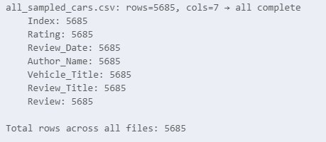
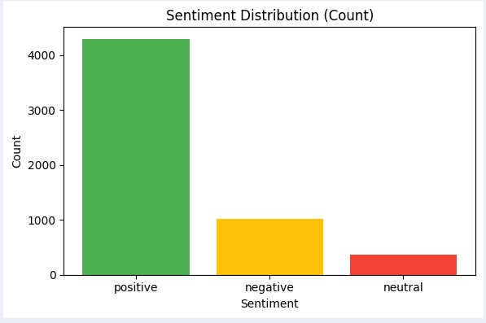
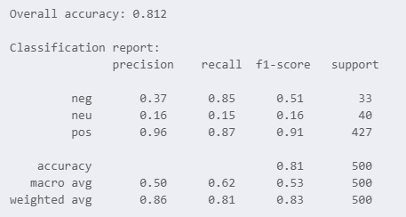
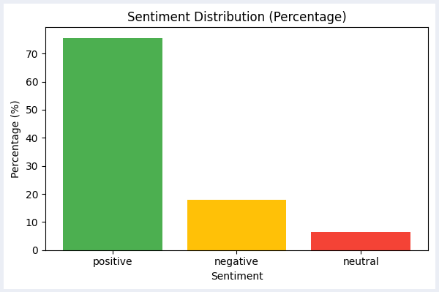
Classification
Results:

Slide 5
Clustering
Latent Dirichlet allocation, LDA
Term Frequency–Inverse Document Frequency, TF-IDF
K-Means Clustering
Data enrichment.
Merged new dataset: Expert Car Reviews, has limited quantity of ~1.5K but more content can be extracted.
Assigned a topic
K-Means Clustering

Slide 6
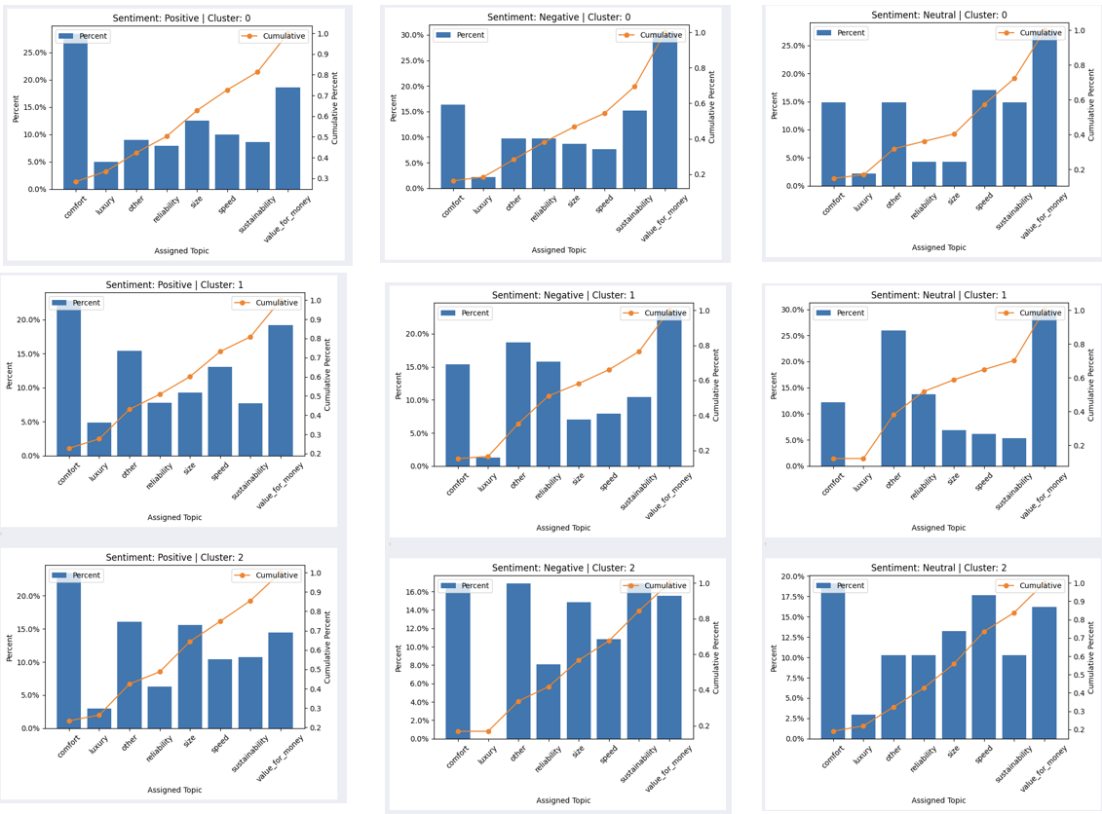
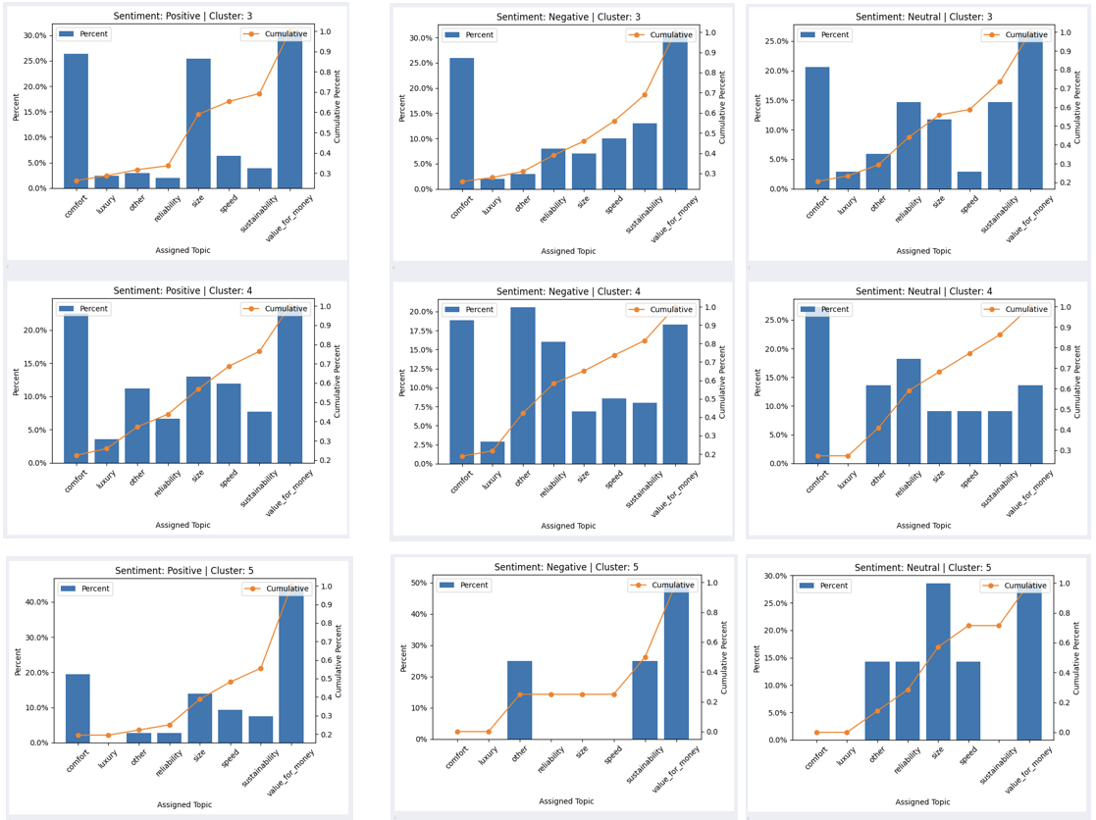
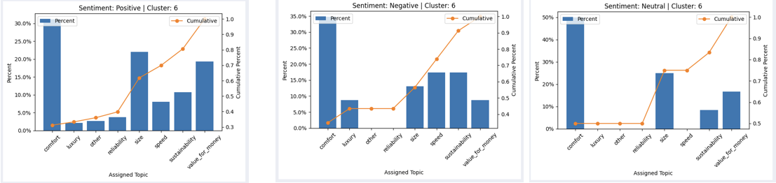
Clustering
Results:

Slide 7
Summarizing
Processed the resulting data from clustering further to fit strategy for recommendation.
Used GPT-3.5-turbo for summarizing.
Few shots
Step by step review.
Chat completion call
Facilitated streamlit for deployment.
Python script which loads data, filters, ranks, user interface rendering

Slide 8

Live Demo

Slide 9
Key take-aways
Know where to get your data.
Begin with an end in mind.
Verify every step.
Test every intended feature.

